Slide 1



A Minor Project I Report on
IMPLEMENTATION OF AUTOMATIC CURTAIN OPENER USING LDR SENSOR FOR IMPARIED PEOPLE
Submitted by
MADHAVAN K SANGEETHA P
SUDHARSHAN D S
(927622BEE065) (927622BEE093)
(927622BEE117)
DEPARTMENT OF ELECTRICAL AND ELECTRONICS ENGINEERING M.KUMARASAMY COLLEGE OF ENGINEERING
(An Autonomous Institution Affiliated to Anna University, Chennai) THALAVAPALAYAM, KARUR-639113.
DECEMBER 2023

Slide 2
M.KUMARASAMY COLLEGE OF ENGINEERING
(Autonomous Institution, Affiliated to Anna University, Chennai)
BONAFIDE CERTIFICATE
Certified that this Report titled “IMPLEMENTATION OF AUTOMATIC CURTAIN OPENER USING LDR SENSOR FOR IMPAIRED PEOPLE” is the Bonafide work of M A D H A V A N . K ( 9 2 7 6 2 2 B E E 0 6 5 ) , S A N G E E T H A . P ( 9 2 7 6 2 2 B E E 0 9 3 )
S U D H A R S H A N . D . S ( 9 2 7 6 2 2 B E E 1 1 7 ) who carried out the work during the academic year (2023-2024) under my supervision. Certified further that to the best of my knowledge the work reported herein does not form part of any other project report.
SIGNATURE SUPERVISOR
Dr S Sathishkumar M.E., Ph.D Associate Professor Department of Electrical
and Electronics Engineering
M Kumarasamy College of Engineering, Karur
SIGNATURE
HEAD OF THE DEPARTMENT
Dr J Uma M.E., Ph.D.,
Professor & Head Department of Electrical and Electronics Engineering
M.Kumarasamy College of Engineering, Karur
Submitted for Minor Project II (18EEP202L) viva-voce Examination held at M..Kumarasamy College of Engineering, Karur-639113 on ………………..
ⅱ

Slide 3
DECLARATION
We affirm that the Minor Project I report titled “IMPLEMENTATION OF
AUTOMATIC CURTAIN USING LDR SENSOR FOR IMPAIRED PEOPLE”
being submitted in partial fulfillment for the award of Bachelor of Engineering in Electrical and Electronics Engineering is the original work carried out by us.
REG.NO | STUDENT NAME | SIGNATURE
927622BEE065 | MADHAVAN K | ------------------------
927622BEE093 | SANGEETHA P | ------------------------
927622BEE117 | SUDHARSHAN D S | ------------------------
ⅲ

Slide 4
VISION AND MISSION OF THE INSTITUTION
VISION
To emerge as a leader among the top institutions in the field of technical education
MISSION
Produce smart technocrats with empirical knowledge who can surmount the global Challenges.
Create a diverse, fully-engaged, learner - centric campus environment toprovide Quality education to the students.
Maintain mutually beneficial partnerships with our alumni, industry and Professional associations.
DEPARTMENT OF ELECTRICAL AND ELECTRONICS ENGINEERING VISION
To produce smart and dynamic professionals with profound theoretical and practical
knowledge comparable with the best in the field.
MISSION
Produce hi-tech professionals in the field of Electrical and Electronics Engineering by inculcating core knowledge.
Produce highly competent professionals with thrust on research.
Provide personalized training to the students for enriching their skills.
PROGRAMME EDUCATIONAL OBJECTIVES (PEOs)
PEO1: Graduates will have flourishing career in the core areas of Electrical Engineering and also allied disciplines.
PEO2: Graduates will pursue higher studies and succeed in academic/research careers
PEO3: Graduates will be a successful entrepreneur in creating jobs related to Electrical and Electronics Engineering /allied disciplines.
PEO4: Graduates will practice ethics and have habit of continuous learning for their success in the chosen career.
ⅳ

Slide 5
PROGRAMME OUTCOMES (POs)
After the successful completion of the B.E. Electrical and Electronics Engineering degree program, the students will be able to:
PO1: Engineering Knowledge: Apply the knowledge of mathematics, science, engineering fundamentals, and an engineering specialization to the solution of complex engineering problems.
PO2: Problem Analysis: Identify, formulate, review research literature, and analyze complex engineering problems reaching substantiated conclusions using first principles of mathematics, natural sciences, and engineering sciences.
PO3: Design/Development of solutions:
Design solutions for Complex engineering problems and design system components or processes that meet the specified needs with appropriate consideration for the public health and safety,and the cultural, societal and environmental considerations.
PO4: Conduct Investigations of complex problems: Use research-based knowledge and research methods including design of experiments, analysis and interpretation of data, and synthesis of the information to provide valid conclusions.
PO5: Modern Tool Usage: Create, select, and apply appropriate techniques, resources, and modern engineering and IT tools including prediction and modeling to complex engineering activities with an understanding of the limitations.
PO6: The Engineer and Society: Apply reasoning in formed by the contextual knowledge to assess societal, health, safety, legal and cultural issues and the consequent responsibilities relevant to the professional engineering practice.
PO7: Environment and Sustainability: Understand the impact of the professional engineering solutions in societal and environmental contexts, and demonstrate the knowledge of, and need for sustainable development.
PO8: Ethics: Apply ethical principles and commit to professional ethics and responsibilities and norms of the engineering practice
ⅴ

Slide 6
PO9: Individual and Team work: Function effectively as an individual, and as a member or leader in diverse teams, and in multi-disciplinary settings.
PO10: Communication: Communicate effectively on complex engineering activities with the engineering community and with society at large, such as, being able to comprehend and write effective reports and design documentation, make effective presentations, and give and receive clear instructions.
PO11: Project Management and Finance: Demonstrate knowledge and understanding of the engineering and management principles and apply these to one’s own work, as a member and leader in a team, to manage projects and in multi-disciplinary environments.
PO12: Life-long learning: Recognize the need for, and have the preparation and ability to engage in independent and life-long learning in the broadest context of technological change.
PROGRAM SPECIFIC OUTCOMES (PSOs)
The following are the Program Specific Outcomes of Engineering Students:
PSO1: Apply the basic concepts of mathematics and science to analyze and design circuits, controls, Electrical machines and drives to solve complex problems.
PSO2: Apply relevant models, resources and emerging tools and techniques to provide solutions to power and energy related issues & challenges.
PSO3: Design, Develop and implement methods and concepts to facilitate solutions for electrical and electronics engineering related real world problems.
Abstract (Key Words) | Mapping of POs and PSOs
LDR Sensor,Battery,555 Timer IC, Two channel Relay Module, DC Motor | PO1, PO2, PO3, PO4, PO5, PO6, PO7, PO8, PO9, PO11, PSO1, PSO2,PSO3
6

Slide 7
ACKNOWLEDGEMENT
Our sincere thanks to Thiru.M.Kumarasamy, Chairman and Dr.K.Ramakrishnan B.E, Secretary of M.Kumarasamy College of Engineering for providing extra ordinary infrastructure, which helped us to complete the Minor project in time.
It is a great privilege for us to express our gratitude to our esteemed Principal Dr.B.S.Murugan M.Tech., Ph.D., for providing us right ambiance for carrying out the project work.
We would like to thank our Head of the Department Dr.J.Uma M.E., Ph.D., Department of Electrical and Electronics Engineering, for their unwavering moral support throughout the evolution of the project.
We would like to express my deep gratitude to our Minor Project Guide Dr.S.SathishKumar M.E., Ph.D., Assistant Professor, Department of Electrical and Electronics Engineering, for his constant encouragement, kind co-operation, valuable suggestions and support rendered in making our project a success.
We offer our whole hearted thanks to our Minor project coordinator Dr.B.RajeshKumar M.E., Ph.D., Assistant Professor, Department of Electrical and Electronics Engineering, for his constant encouragement, kind co-operation and valuable suggestions for making our project a success.
We glad to thank all the Faculty Members of Department of Electrical and Electronics Engineering for extending a warm helping hand and valuable suggestions throughout the project.
Words are boundless to thank Our Parents and Friends for their constant encouragement to complete this Minor project successfully.
7

Slide 8
TABLE OF CONTENTS
CHAPTER NO | CONTENTS | PAGE NO
 | ABSTRACT | xi
 | LIST OF FIGURES LIST OF TABLES | ⅸ ⅹ
 | SURVEY FORM | 1
1 | SURVEY FORM ANALYSIS Name and Address of the Community Problem Identification Solution
 |  | 4 4 4
2 | LITRATURE REVIEW Smart Home System with Automatic Curtain Opener IOT-based Curtain Control System Voice-Activated Curtain Opener Gesture-Controlled Smart Curtains Machine Learning Adaptive Curtain System
 |  | 5 5 5 5 6
3 | PROPOSED METHODOLOGY Block Diagram Description Cost Estimation
 |  | 7 8 12
4 | FUTURE SCOPE AND ITS IMPLEMENTATION PLAN | 13
5 | REFERENCES | 14
3

Slide 9
LIST OF FIGURES
FIGURE NO | TITLE | PAGE NO
3.1 | Block Diagram of Automatic Curtain Opener Using LDR Sensor | 9
3.2 3.3 | Pin Diagram 555 TIMER IC Light Dependent Resistor (LDR) | 11 13

Slide 10
LIST OF TABLES
TABLE NO | TITLE | PAGE NO
3.3 | Cost Estimation | 14

Slide 11
ABSTRACT
This project introduces an innovative automatic curtain opener system designed to enhance convenience and energy efficiency in residential and commercial spaces. the system detects ambient light levels, user preferences, and environmental conditions to autonomously open or close curtains. Integrated with a user-friendly interface, it provides manual control options and can be seamlessly integrated into smart home ecosystems. The automated functionality aims to optimize natural light utilization, promote energy conservation, and elevate the overall comfort and modernity of living spaces. Additionally, the automatic curtain opener system incorporates machine learning algorithms to adapt to user routines, learning patterns of curtain usage over time. This adaptive feature ensures a personalized experience, anticipating user preferences and creating a more intuitive and efficient curtain control system. The project presents the development and implementation of a system designed to enhance the convenience, energy efficiency, and comfort of residential and commercial spaces. The LDR sensor enabling the system to detect changes in natural light levels. Based on this real-time data, the curtains or blinds are autonomously opened or closed, ensuring optimal lighting conditions. a novel solution that not only aligns with the demands of modern living but also contributes to a more sustainable and user- friendly environment. Based on the lighting condition curtain will move automatically Smart curtains with sensors can detect changes in ambient light, adjusting themselves accordingly. This can help to save energy by minimizing the need of artificial lighting and heating/cooling systems Smart curtains can be integrated to open and close the curtain without physical effort. This enhances accessibility and independence for members of the community with disabilities. It does the task of folding unfolding of the curtain as per the light intensity outside the window. It is an automatic process, and the light intensity is sensed by LDR in the circuit. In this operation using the DC motor for the curtain folding and unfolding.
Keywords: LDR Sensor, Battery, 555 Timer IC, Two channel Relay Module, DC Motor

Slide 12
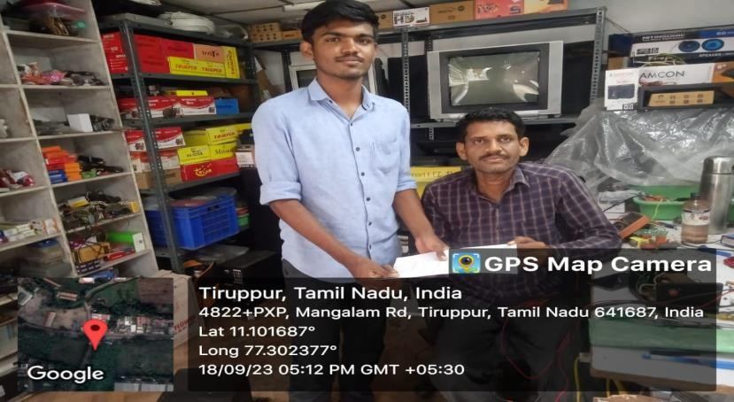
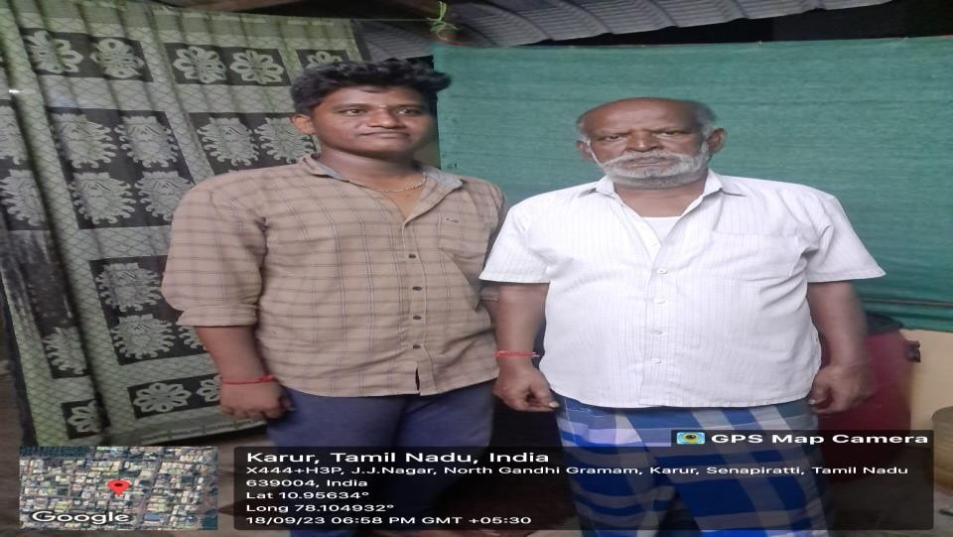
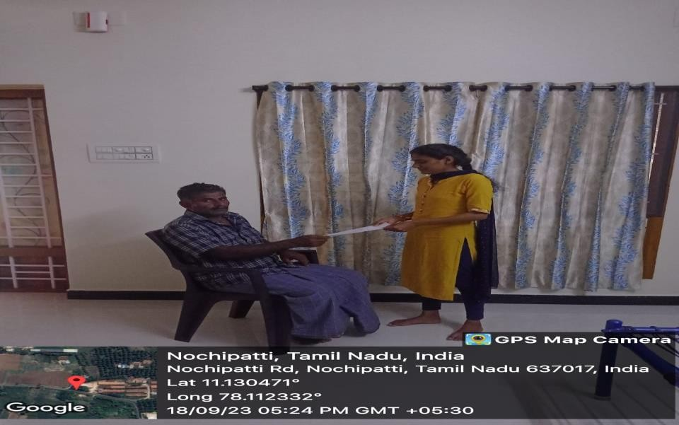
SAMPLE PHOTOS
3

Slide 13
CHAPTER 1
SURVEY FORM ANALYSIS
NAME AND ADDRESS OF THE COMMUNITY:
NAME: P. Govindaraj
ADDRESS: 1/141, Laxmi Nagar, Chinnandipalayam, Tiruppur-641687.
NAME: K. Alagappan
ADDRESS: JJ Nagar, EB Colony, Gandhigrammam, Karur-639005.
NAME: K. Sekar
ADDRESS: Nochipatti, Namakkal-637017.
NAME: N. Natarajan
ADDRESS:1/14, Upputhottam, Mangalam, Tiruppur-641663
NAME: P. Muthupandi
ADDRESS: JJ Nagar, EB Colony, Gandhigrammam, Karur-639005
PROBLEM IDENTIFICATION:
From the survey we find that, it's hard for older and physically challenged people to open curtains by hand because it requires a lot of physical effort. This problem becomes especially important for those dealing with memory loss (amnesia) and the aging process, making it even tougher to manage the curtains manually.
SOLUTION:
The solution could be implementing automated curtain systems that can be controlled
with a LDR sensor. This technology can significantly ease the task for older and physically challenged individuals, including those dealing with memory loss, providing them with more independence in managing their curtains.

Slide 14
CHAPTER 2
LITERATURE REVIEW
Smart Home System with Automatic Curtain Opener
Inference: Explore the design and implementation of a system that utilizes LDR sensors
to detect ambient light levels, allowing for automatic curtain opening and closing to enhance the comfort and independence of visually impaired individuals.
IOT-based Curtain Control System
Inference: Develop a project that leverages Internet of Things (IOT) technology,
integrating LDR sensors with a curtain control system. This solution enables users to manage their curtains remotely through a mobile app, catering to those with limited mobility.
Voice-Activated Curtain Opener
Inference: Create a system where LDR sensors are integrated with a voice recognition
module to enable visually impaired individuals to control their curtains using voice commands, providing a hands-free and user-friendly experience.
Gesture-Controlled Smart Curtains
Inference: Investigate the implementation of a gesture-controlled curtain opener, employing LDR sensors to detect changes in light conditions. Users can perform specific gestures to open, close, or adjust the curtains, enhancing accessibility for people with different abilities.

Slide 15
2.5 Machine Learning Adaptive Curtain System
Inference: Develop a project that employs machine learning algorithms to analyze user preferences and daily routines. The system uses LDR sensors to optimize curtain positions based on the user's behavior, offering a personalized and adaptive solution for individuals with varying needs.

Slide 16
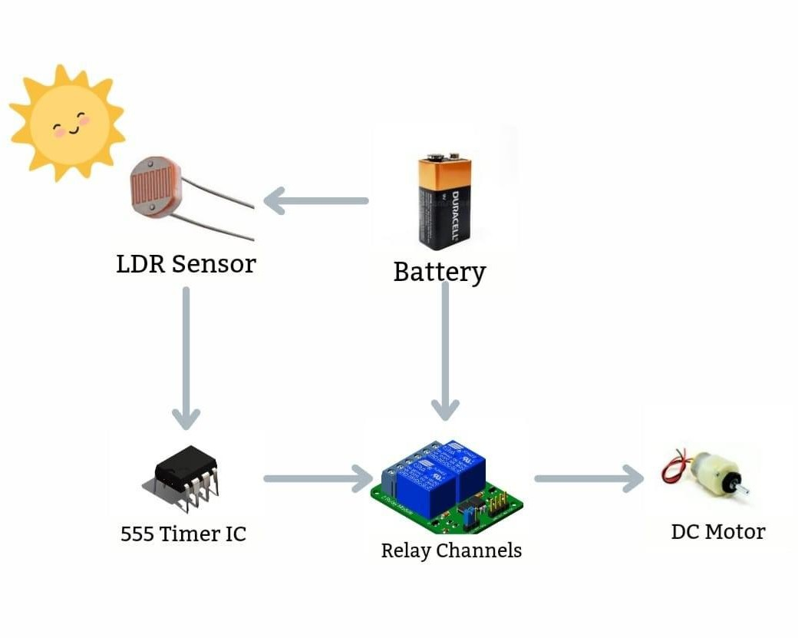
CHAPTER 3
PROPOSED METHODOLOGY OF AUTOMATIC CURTAIN OPENER USING LDR FOR IMPAIRED PEOPLE
3.1 BLOCK DIAGRAM OF AUTOMATIC CURTAIN OPENER USING LDR FOR IMPAIRED PEOPLE
Fig.No 3.1 Block diagram of automatic curtain opener using LDR sensor.

Slide 17
3.2 DESCRIPTION
Two separate LDR circuits are used here. One senses the darkness and the other one is for light sensing. Deploying two separate circuits, one for sensing the light and the other for the darkness, ensures the proper reversal of rotation of the motor in one of the cases. The output of the respective LDRs are connected with two timer ICs set with time delays sufficient to fold and unfold the curtain. Light sensing LDR circuit is inactive when exposed to darkness and vice-versa. Output of the respective timers reaches the motor via 2 channel relay modules. Motor runs for the time period determined by the delay provided in each of the cases and the curtain moves accordingly. The time delay for each of the cases can be set by using different values of resistor and capacitor in the timer circuit. To help the people with disability by the automated curtain opener which reduces their physical effort. Smart curtains with sensors can detect changes in ambient light, adjusting themselves accordingly. This can help to save energy by minimizing the need of artificial lighting and heating/cooling systems. Smart curtains can be integrated to open and close the curtain without physical effort. This enhances accessibility and independence for members of the community with disabilities.
3.2.1 Relay
These well-contained modules are inexpensive, simple to connect, and ideal for home-brew projects that require switching modest amounts of AC or DC power. The only downside is that, because these are electro-mechanical devices, they are more prone to wear and tear over time. This is set up to use relay module to turn on a lamp or other device, but first, a

Slide 18
quick primer on relays. At the core of a relay is an electromagnet . A relay can be thought of as an electric lever; you turn it on with a relatively small current, and it turns on another device with a much larger current.
3.2.2 555 TIMER IC
The 555 timer IC integrated circuit (chip) used in a variety of timer, delay, pulse generation, and oscillator applications. Derivatives provide two (556) or four (558) timing circuits in one package. The design was first marketed in 1972 by signetics. Since then, numerous companies have made the original bipolar timers, as well as similar low-power CMOS timers. In 2017, it was said that over a billion 555 timers are produced annually by some estimates, and that the design was "probably the most popular integrated circuit ever made" The timer IC was designed in 1971 by Hans Camenzind under contract to signetics . In an oscillator for PLLs such that the frequency did not depend on the power supply voltage or temperature. Signetics subsequently laid off half of its employees due to the 1970 recession 1968, he was hired by Signetics to develop a phase locked loop (PLL) IC.

Slide 19
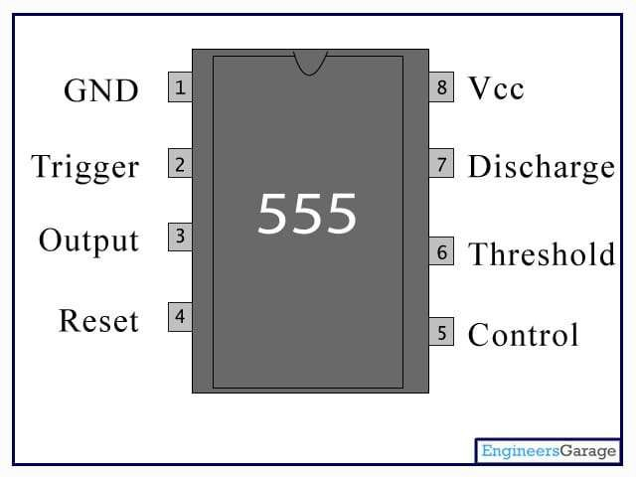
Fig.No.3.2 Pin Diagram 555 TIMER IC
3.2.3 DC Motor
A DC motor is any of a class of rotary electrical motors that converts direct current (DC) electrical energy into mechanical energy. The most common types rely on the forces produced by induced magnetic fields due to flowing current in the coil. Nearly all types of DC motors have some internal mechanism, either electromechanical or electronic, to periodically change the direction of current in part of the motor. DC motors were the first form of motors widely used, as they could be powered from existing direct-current lighting power distribution systems. A DC motor's speed can be controlled over a wide range, using either a variable supply voltage or by changing the strength of current in its field windings. Small DC motors are used in tools, toys, and appliances. The universal motors a light weight brushed motor used for portable power tools and appliances can operate on direct current and alternating current. Larger DC motors are currently used in propulsion of

Slide 20
electric vehicles, elevator and hoists, and in drives for steel rolling mills. The advent of power electronics has made replacement of DC motors with AC motors possible in many applications.
3.2.4 Breadboard
A breadboard or protoboard is a construction base for prototyping of electronics. The purpose of the breadboard is to make quick electrical connections between components like resistors, LEDs, capacitors. So that you can test your circuit before permanently soldering it together. Breadboards have many small sockets on them, and some groups of sockets are electrically connected to each other.
3.2.5 LDR
LDR is a light-dependent resistor that changes its resistance when different amount
of light fall on it. They work on the principle of photo conductivity where it gives less Resistance in high light intensity and high resistance in low light intensity. In other
Words, it gives high resistance at night and low resistance in day. LDRs are made from Semiconductor materials like cadmium sulphide, which help the lights to have their
Light sensitive properties. When light falls on the surface of LDR, the conductance of The element increases or the resistance of the LDR in the control circuit falls. When
It becomes dark, the resistance of the LDR increases and switches the light on.

Slide 21
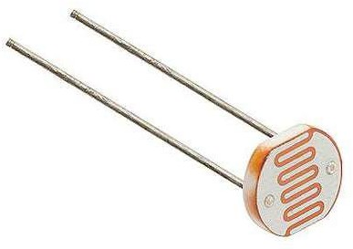
Fig.No.3.3 Light Dependent Resistor (LDR)
3.3 COST ESTIMATION
S.NO | COMPONENT DESCRIPTION | QUANTITY | COST
1 | LDR (Light Dependent Resistor) | 2 | 40
2 | 555 Timer IC | 2 | 50
3 | DC Motor | 1 | 180
4 | Two Channel Relay Module | 1 | 260

Slide 22
5 | Transistor | 2 | 100
6 | Additional Components | - | 220
 |  | TOTAL | 850
Table No.3.3 Cost Estimation
CHAPTER 4
FUTURE SCOPE & ITS IMPLEMENTATION PLAN
The future scope of automatic curtain openers involves advancements in technology and integration with smart home systems. Implementation could include:
Smart Integration: Integration with voice assistants (like Alexa or Google Assistant) for hands-free control, and compatibility with smart home platforms to enable automation

Slide 23
scenarios.
Sensor Technology: Enhanced sensors, beyond just LDR, like motion sensors or environmental sensors to adjust curtains based on factors such as temperature, time of day, or occupancy.
Energy Efficiency: Incorporating energy-efficient motors and mechanisms, as well as
the ability to sync with climate control systems to optimize natural light and reduce energy consumption.
Customization and Learning Algorithms: Utilizing machine learning algorithms to understand user preferences over time and automatically adjusting curtains accordingly.
Mobile App Control: Developing a dedicated mobile app for users to control curtains remotely, set schedules, and receive notifications or insights on energy savings.
Security Integration: Integration with home security systems to simulate presence by adjusting curtains during periods of absence.
Design Aesthetics: Focus on sleek and compact designs to seamlessly blend with modern interior aesthetics.
As technology evolves, these implementations could enhance user experience, energy
efficiency, and the overall integration of automatic curtain openers into smart living environment.

Slide 24
REFERENCES:
J. Su and J. Zeng, "Double Fans Fluctuation System for Building Curtain Wall Test", Construction Quality, vol. 29, no. 3, pp. 60-62, 2011.
D. Wang, S. Wu and G. Zhang, "Active step-up and step-down pressure regulating valve for three-character detection device of building doors windows and curtain walls", CN PAT: CN102141162A, August 2011.
Gurpreet Kaur, Mohit Srivastava and Amod Kumar, "Analysis of feature extraction methods for speaker dependent speech recognition", International journal of engineering and technology innovation, vol. 7, no. 2, pp. 78-88, 2017.
J. Basnayake, R. Amarasinghe, R. Attalage, T. Udayanga and A. Jayasekara, "Artificial Intelligence Based Smart Building Automation Controller for Energy Efficiency Improvements in Existing Buildings", International Journal of Advanced Information Science and Technology (IJAIST), vol. 40, no. 40, August 2015.
Wang, Yibo & Zhang, Yufeng & Li, Hongyi & Ji, Beibei. (2015). Design for intelligent control system of curtain based on Arduino. 10.2991/icecee-15.2015.251.
Automatic curtain blind using Arduino :
https://www.instructables.com/Automatic-CurtainWindow-Blind-Using-Arduino- and-LD/?amp_page=true
Motorized curtain with remote control:
http://slab.com/project/motorizedcurtainwithremotecontrol/&sa=U&sqi=2&ved=2a hUKEwiXpeaLt5qDAxXVxzgGHfKBuYQFnoECCcQAQ&usg=AOvVaw10VxD_ 0-bEIrcBuQ6nJyZL
15

Slide 25
IMPLEMENTATION VIDEO LINK: https://www.veed.io/view/bf9c8e58-57ed-4ba1-98fc-d46ef97e0b5d?panel=
PROJECT KIT PICTURE:
“IMPLEMENTATION OF AUTOMTIC CURTAIN OPENING USING LDR SENSOR FOR IMPAIRED PEOPLE”
16

Slide 26
IMPLEMENTATION PICTURE:
17

